Slide 1
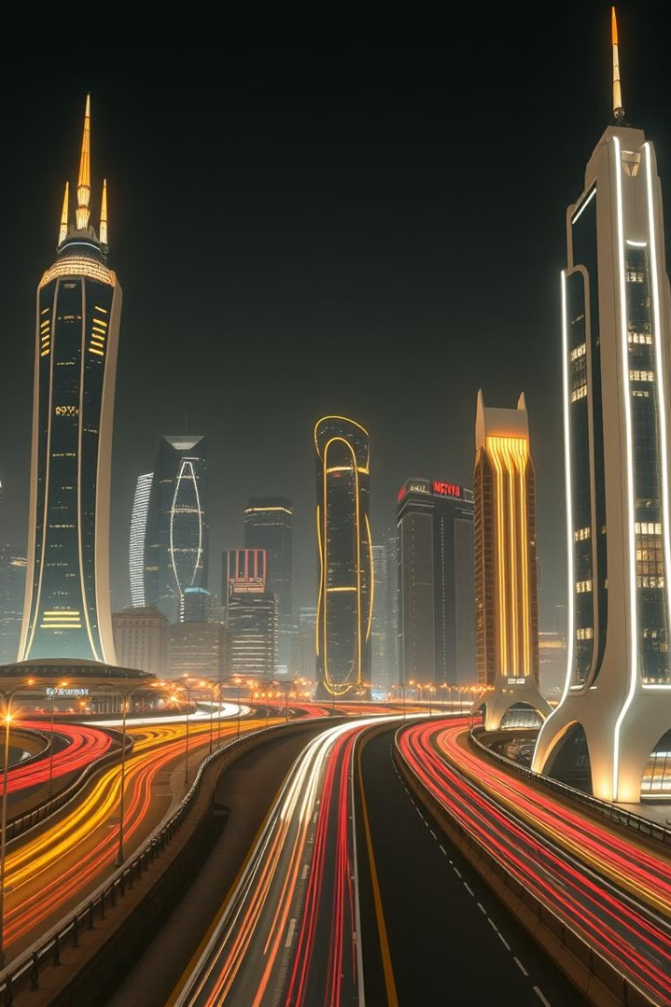
Smart Traffic Light Control System
Intelligent traffic management using ESP32 and IR sensors. Optimizing urban traffic flow for efficiency and sustainability. This presentation outlines the project details, technical architecture, and implementation.

Slide 2

Project Details
Student: 24CE055 URVAL KHENI
24CE064 HEET MEHTA
24CE065 OM MISTRY
Department: Computer Engineering
Lab: Robotics and IoT Research Lab
Year: 2024-2025

Slide 3
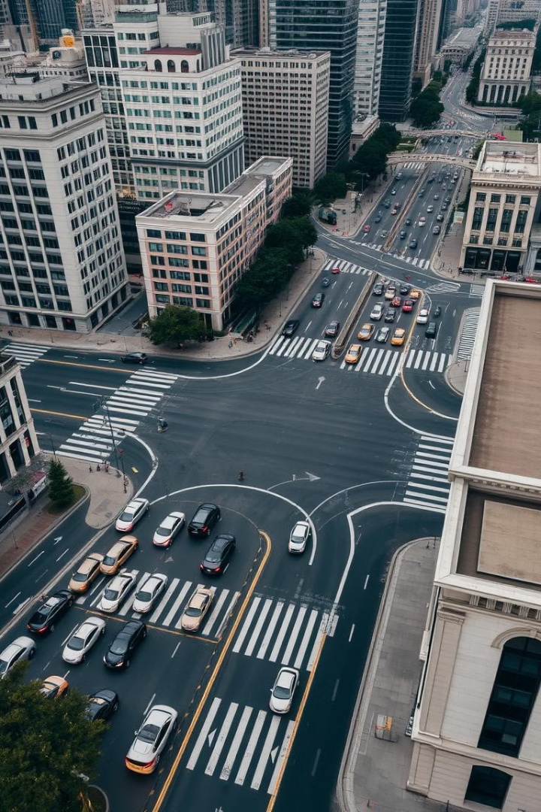
Problem Statement
Urban traffic congestion costs billions each year. Traditional signals lack adaptive control. Significant time is wasted at intersections. The need for intelligent traffic management is critical and ease of traffic communication.

Slide 4
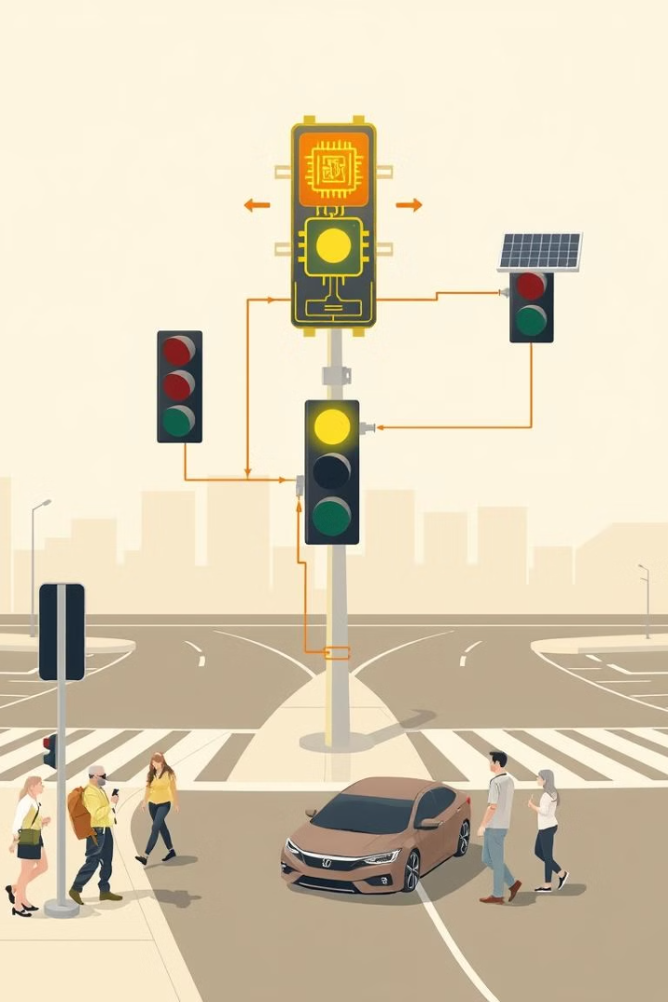
Technical Architecture
ESP32 microcontroller serves as the CPU. IR sensors provide real-time vehicle detection. The system uses adaptive signal(IR Sensor) timing optimization. It’s a low-power embedded system design.

Slide 5
System Implementation
IR sensor array monitors intersections.
Machine learning predicts traffic flow.
Dynamic signal timing is adjusted.
IoT communication protocol used.
95% accuracy in traffic management.

Slide 6
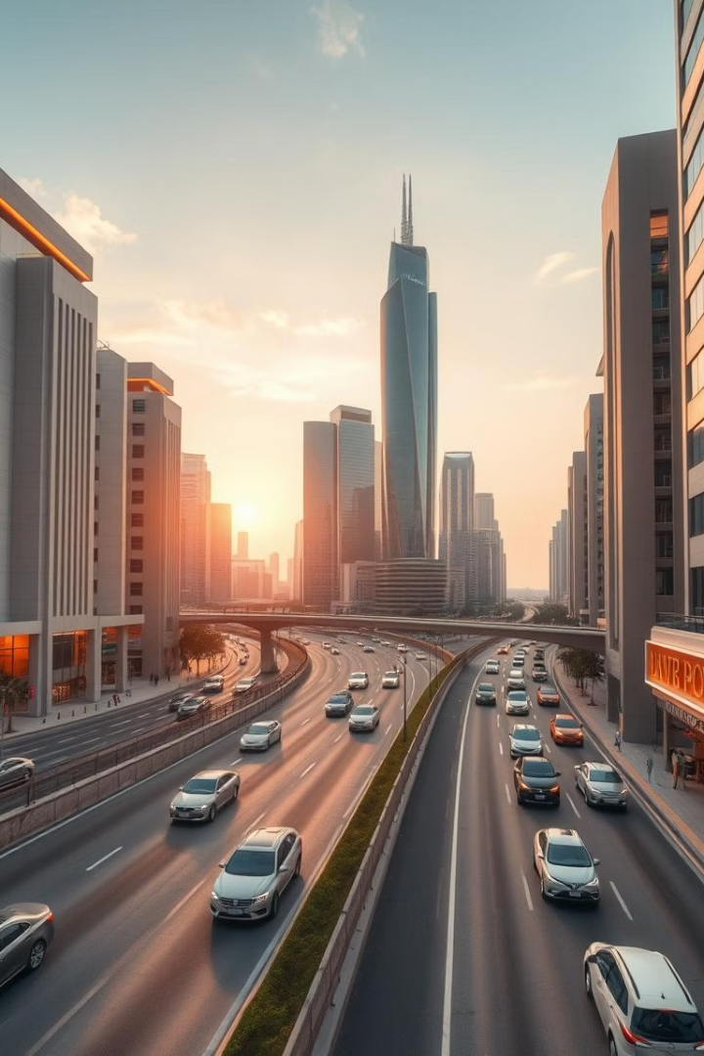
Conclusion and Future Scope
Potential for citywide traffic optimization. Reduce congestion by 40%. Scalable for smart city solutions. Next steps include large-scale pilot implementation ,we can aslo use camera approach with openCV we can execute with it.

